Slide 1

Service mapping the scheduling experience
How we support Veterans across the appointment journey
Name, Role
name@example.com
Name, Role
name@example.com
July 8, 2019

Slide 2

Intro to Service Mapping

Slide 3
A service map helps us...
Gain a big picture view of the state of the Veteran scheduling experience
Identify broken, painful, or inconsistent Veteran experiences
Identify critical moments, breakdowns, and ask questions
Generate ideas and identify opportunities for improvements

Slide 4
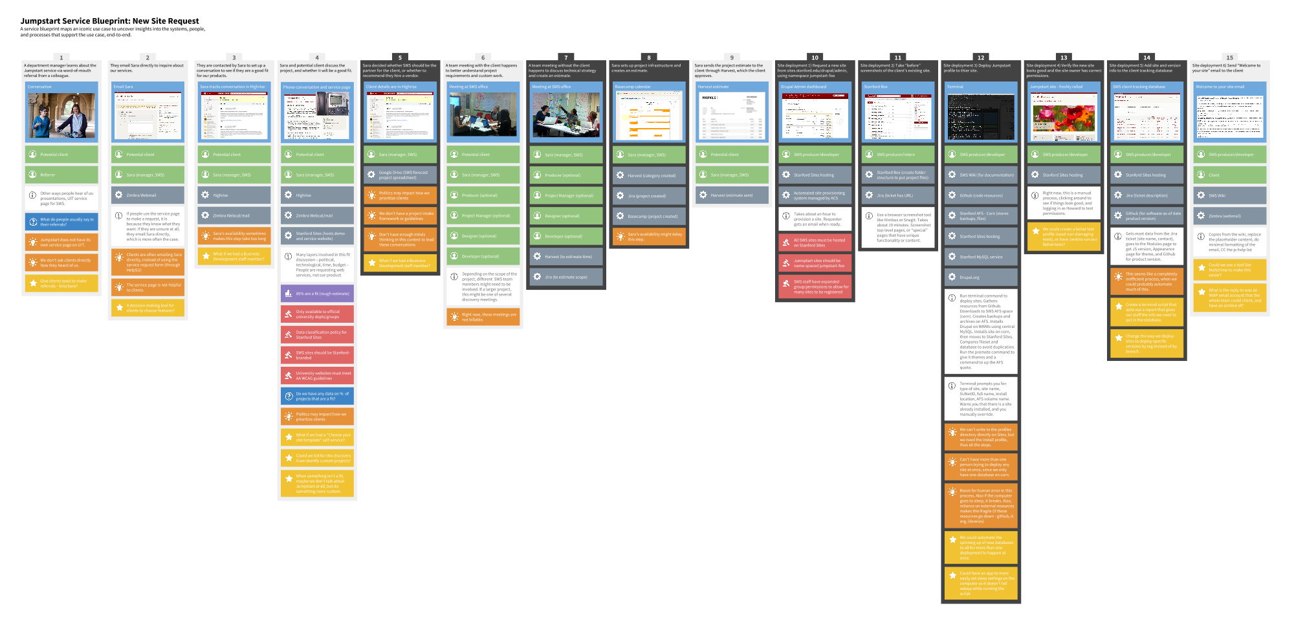
How a service map works

Slide 5








The layers
Step description
Touchpoint
Actor
System
Paint the picture
Observation/Fact
Metric/Data callout
Policy/Rule
Follow-up question
Critical Moment
Capture insight
Opportunity/Idea
Notes:
Touchpoint
The what/where of the interaction of the step—what is the actor interacting with?
A touchpoint represents a specific interaction between a customer and an organization. It includes the device being used, the channel used for the interaction, and the specific task being completed.
Veteran calls VA to schedule.
Step description
A plain-words, short description of what is happening in the step.
Observation/Fact
Observations or facts that are important to note to add detail to the step.
Metric
Data or statistics that help us understand the step better.
Actor
Question
￼
￼
The end-user experiencing the service, or any service staff or other people involved in the step.
Questions about this step that need to be followed up on.
System
Critical Moment
￼
￼
The technology, hardware, infrastructure, or processes that support this step.
Potential or actual breakdowns of the service experience that are sources of pain for end-users.
Policy
Opportunity
￼
￼
The rules or regulations that dictate why something is a certain way in this step.
Ideas or “ah-ha” insights about how you could improve the service experience or service delivery.

Slide 6
The layers
Visible
Hidden
Step description
Step description
Touchpoint
Touchpoint
Actor
Actor
System
System
Observation/Fact
Observation/Fact
Metric/Data callout
Metric/Data callout
Policy/Rule
Policy/Rule
Follow-up question
Follow-up question
Breakdown
Breakdown
Opportunity
Opportunity

Slide 7
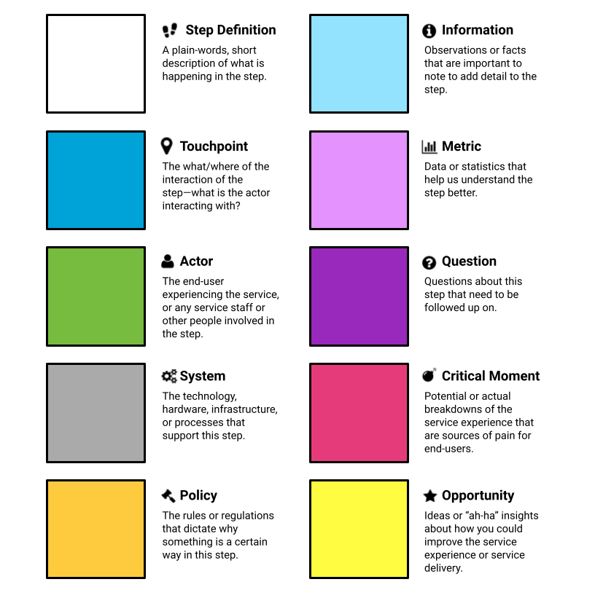
The layers

Slide 8
Map scenarios across the Veteran scheduling journey
Customer requests service
Set-up service for customer
Onboarding
Use the service
Complete engagement
End-to-end

Slide 9
Map scenarios across the Veteran scheduling journey
Break down phases of scenarios
Customer requests service
Set-up service for customer

Slide 10
“Mine” your map for actionable insights
Opportunity
Critical Moment
Opportunity
Opportunity
Critical Moment
Critical Moment
Critical Moment
Opportunity
Opportunity
Critical Moment
Opportunity
Critical Moment
Opportunity
Opportunity
Opportunity
Critical Moment
Critical Moment
Critical Moment
Critical Moment
Opportunity
Critical Moment
Opportunity
Opportunity

Slide 11
Output of the map...
A holistic view of the Veteran scheduling process at this facility
Shared understanding of the critical moments
Ideas for improvement

Slide 12
Let’s map!

